Slide 1

Heart Disease Prediction Analysis
CONTINUE
Here is your presentation begins
Presented By :Ganesh Sasale

Slide 2
TABLE OF CONTENTS
PREV
NEXT
Introduction
Data Gathering
EXPLORATORY DATA ANALYSIS
Reason causing Heart Diseases Models and early detection bring essential benefits
Comprehensive Dataset Overview Refinement and Data Preparation Steps
Find patterns and identify trends
Gain valuable insights from the dataset
Feature Extraction
ML Methods
Experiment Results
Visuals of Compared models Accuracy, confusion matrix of models
Divide Features into X and Y Machine Learning
Algorithms or Models Used Compare each Evaluate Algorithm

Slide 3
Introduction
PREV
NEXT
Cardiovascular Diseases (CVDs) are a group of health problems that affect the heart and blood vessels.
A common issue related to CVDs is heart failure, which happens when the heart can't pump blood properly. Detecting these problems early can be crucial for treatment, and data science can play a big role in this.
In this dataset, we look at various health indicators related to heart disease. It includes 13 important features like age, blood pressure, cholesterol levels, and chest pain.
The main goal is to predict if a person has heart disease based on these features. This helps doctors understand and address potential health issues before they become serious.

Slide 4
PREV
NEXT
Global burden of Cardiovascular Disease
Our world population in 2023 is 8 billion! Of these, around 620 million people are living with heart and circulatory diseases across the world.
Each year around 60 million people across the world develop a heart or circulatory disease.

Slide 5
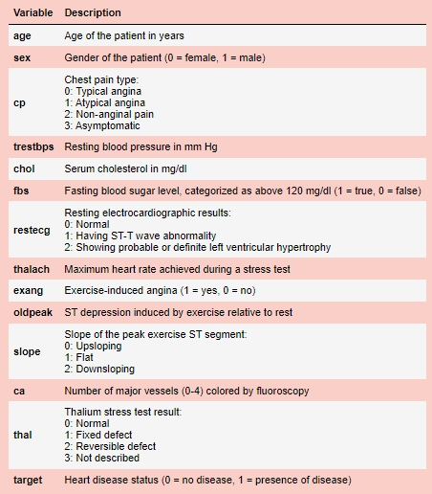
Data Collection And Refinement
PREV
NEXT

Slide 6
Exploratory Data Analysis
PREV
NEXT
This step helped us get to know our data better. We looked at how the data is organized, discovered patterns, and found useful information to understand the dataset.
By analyzing the data, we checked how each feature (or column) is distributed and how different features are related to each other.
Graphs and charts made it easier to see the data, understand how different health indicators are connected, and identify important factors for predicting heart disease.
Our dataset is clean because there are no missing values. However, we did find some duplicate entries and unusual data points (outliers).
We noticed that some columns were numerical but should be treated as categories (like types of chest pain). We changed their data type to "object" for better analysis.
We used two methods to understand the data: looking at each feature individually (univariate analysis) and exploring how each feature relates to our main goal (predicting heart disease) through comparisons (bivariate analysis).

Slide 7
SYMPTOMS OF THE HEART DISEASE
PREV
NEXT
Chest Pain
Dizziness
Tiredness
Swelling
Fast or Irregular Heartbeat
Shortness of Breath

Slide 8
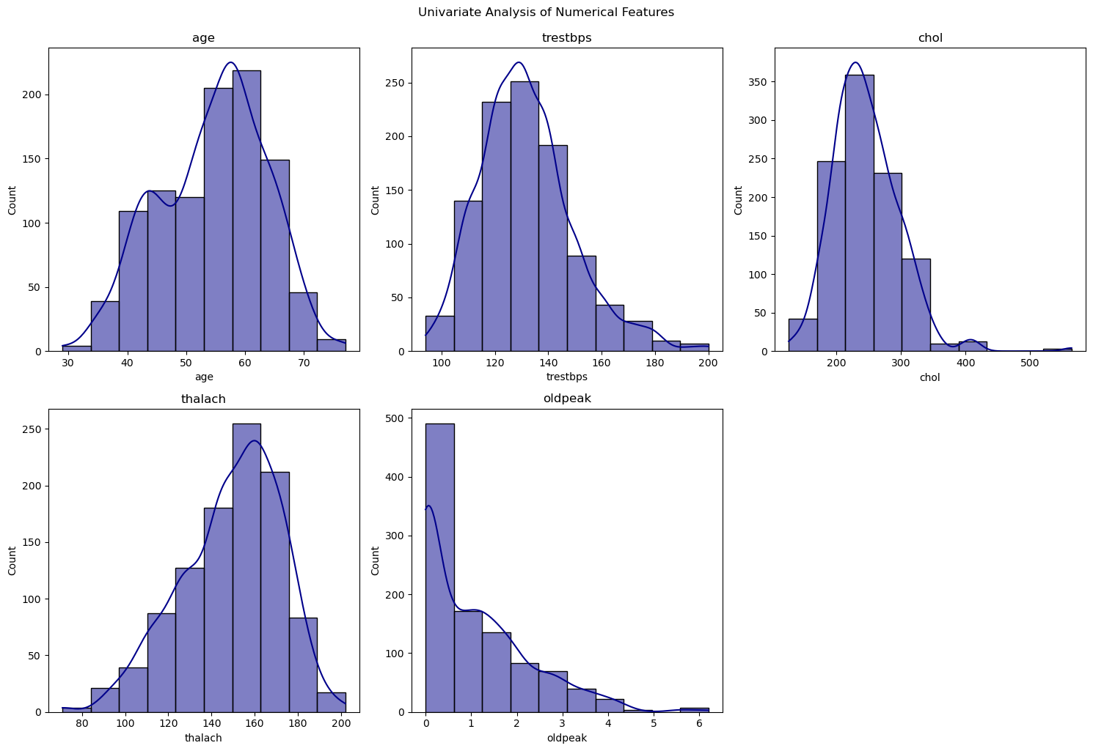
DISTRIBUTION OF CONTINUOUS VARIABLE

Slide 9
CONTINUOUS VARIABLE
Age: Most people in the data are in their late 50s. On average, they are about 54 years old.
Resting Blood Pressure: Most people have a blood pressure between 120 and 140. On average, it’s about 132.
Cholesterol: The average cholesterol level is between 200 and 280.
Maximum Heart Rate (Thalach): During a stress test, most people’s heart rates are between 140 and 170 beats per minute.
Old peak (ST Depression Induced by Exercise): Most people did not have much ST depression during exercise, which means their heart’s electrical activity looked normal.

Slide 10
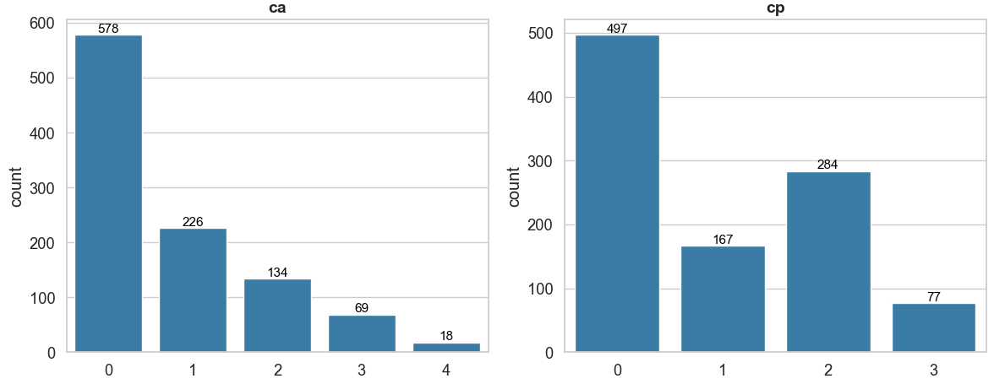
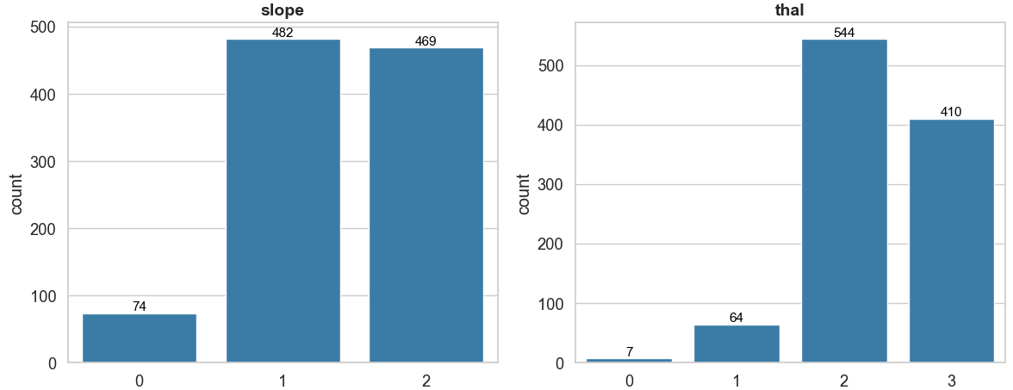
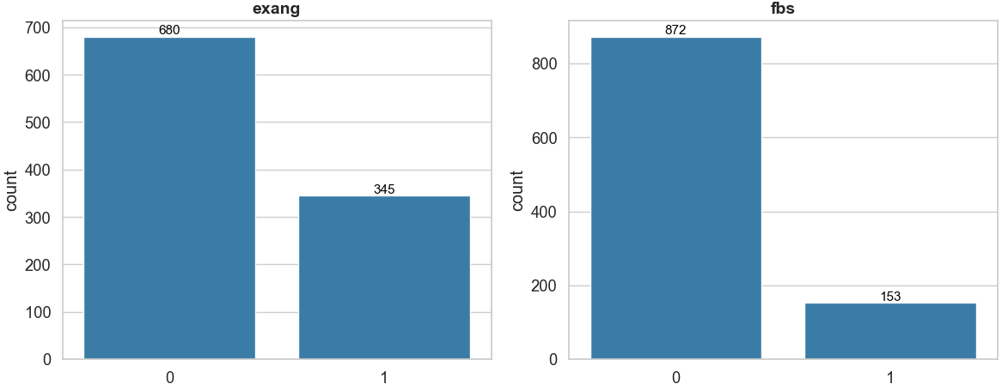
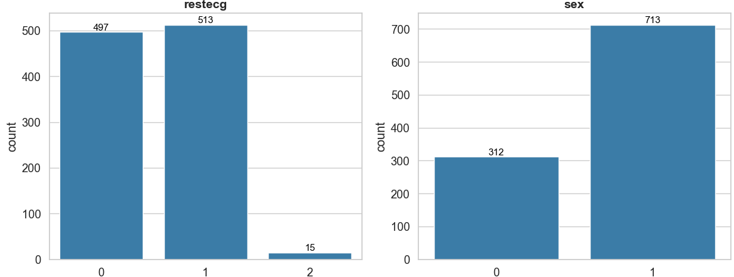
DISTRIBUTION OF CATEGORICAL VARIABLE

Slide 11
CATEGORICAL VARIABLE
Chest Pain (Cp): The most common type of chest pain in this data is "Typical Angina," which means many people in the dataset have this kind of pain.
Fasting Blood Sugar (Fbs): Most people in the data have a fasting blood sugar level below 120 mg/dl, so high blood sugar is not very common in this dataset.
Exercise-Induced Angina (Exang): Most people don’t experience chest pain during exercise, suggesting it’s not a common symptom for the patients in this data.
Slope of the Peak Exercise ST Segment (Slope): Two types of slopes are more common: "Flat" and "Downsloping.“
Thallium Stress Test Result (Thal): The type of result called "Reversible Defect" is the most common in this dataset.
Number of Major Vessels Colored by Fluoroscopy (Ca): Most people have fewer major blood vessels colored during the test, with "0" being the most common number.

Slide 12
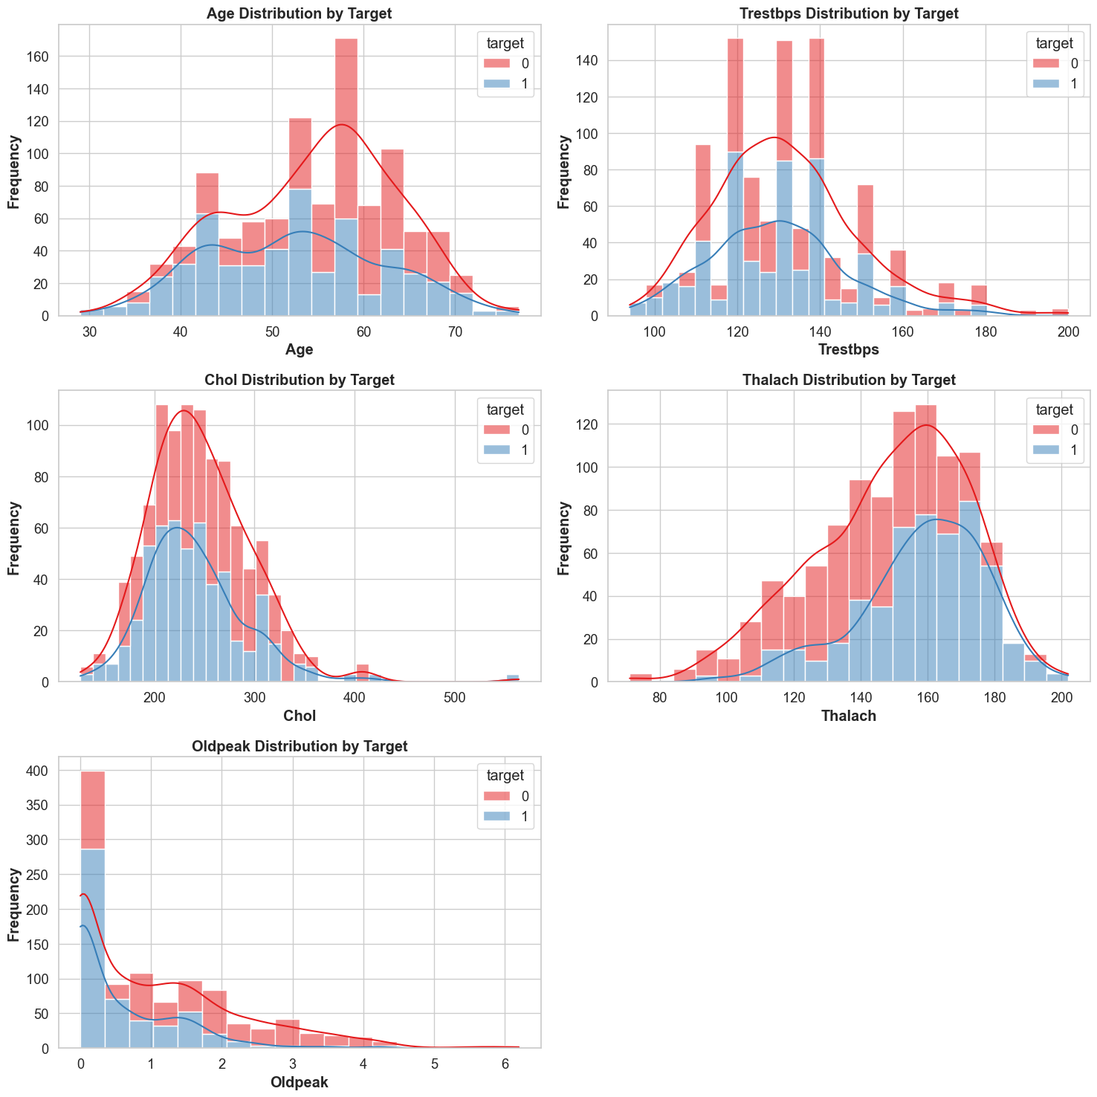
DISTRIBUTION CONTINUOUS VARIABLE vs TARGET

Slide 13
CONTINUOUS VARIABLE vs TARGET
Age: People with heart disease are, on average, a bit younger than those without it. Those without heart disease are usually older.
Resting Blood Pressure: The blood pressure levels for both groups (with and without heart disease) look very similar, so it’s not very useful for telling the difference between the two groups.
Serum Cholesterol: Cholesterol levels are also similar for both groups, but people with heart disease have a slightly lower average cholesterol level.
Maximum Heart Rate Achieved: People with heart disease tend to reach a higher maximum heart rate during stress tests compared to those without heart disease.
ST Depression: People with heart disease show much less ST depression during exercise. Their results are mostly close to zero, while those without heart disease show a wider range of results.

Slide 14
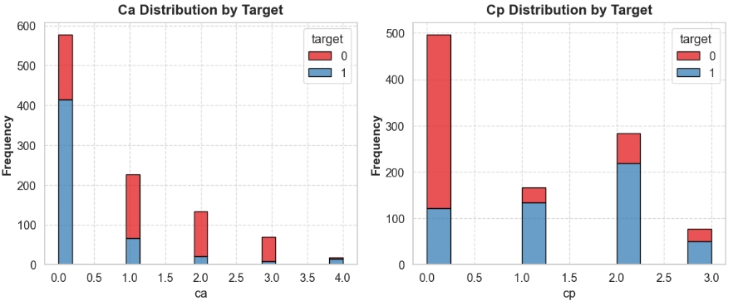
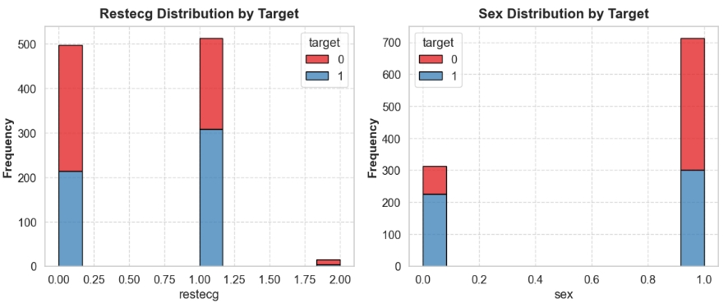
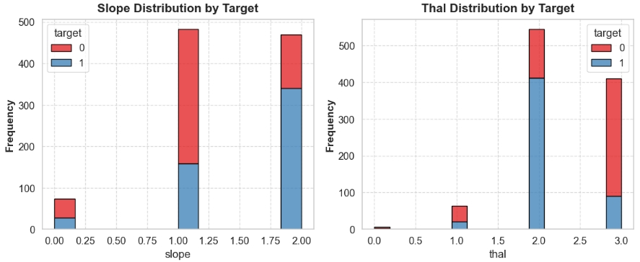
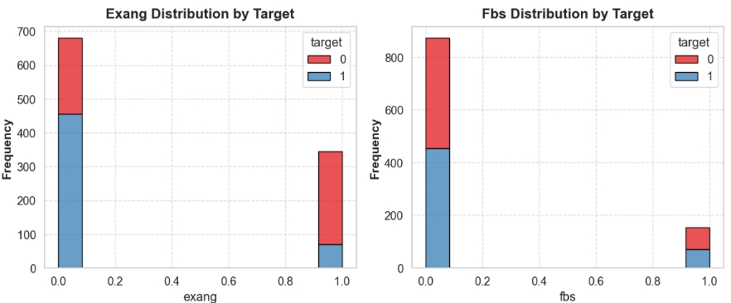
DISTRIBUTION FOR CATEGORICAL VARIABLE vs TARGET

Slide 15
CATEGORICAL VARIABLE vs TARGET
Number of Major Vessels: Most people with heart disease have fewer major vessels showing up in the test. If someone has 0 vessels colored, they are more likely to have heart disease.
Chest Pain Type: Different types of chest pain are linked to heart disease in different ways. Types 1, 2, and 3 are more common in people with heart disease, suggesting that chest pain type can help predict the disease.
Exercise-Induced Angina: People who don’t have chest pain during exercise are more likely to have heart disease compared to those who do have chest pain during exercise. This feature seems important for predicting heart disease.
Fasting Blood Sugar: There isn’t a big difference in heart disease rates between people with high fasting blood sugar and those with normal levels. This suggests that fasting blood sugar might not be very useful for predicting heart disease.
Resting Electrocardiographic Results: The type of resting electrocardiogram result can indicate heart disease. Specifically, type 1 is more common in people with heart disease.
Sex: Women are less likely to have heart disease compared to men, suggesting that gender plays a role in predicting heart disease.
Slope of the Peak Exercise ST Segment: The type 2 slope is more common in people with heart disease, making it a useful indicator for prediction.
Thalium Stress Test Result: The category showing a reversible defect (2) is more common in people with heart disease, highlighting its importance in prediction.

Slide 16
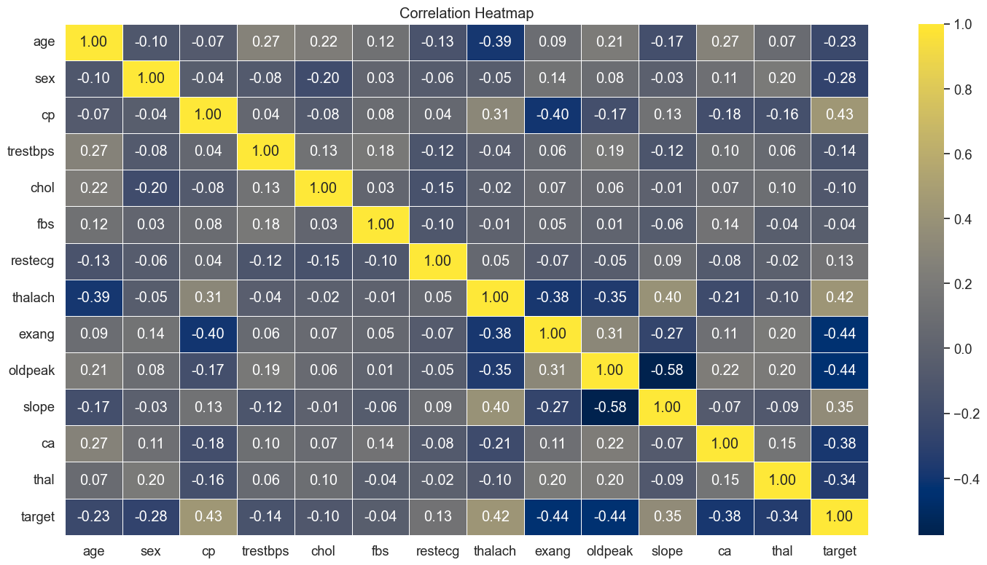

Slide 17
Correlation Heatmap
Positive Correlation: The target (heart disease presence) is more likely to be related to:
Chest Pain (Cp): If someone has chest pain, they might be more likely to have heart disease.
Maximum Heart Rate (Thalach): A higher maximum heart rate might be linked to heart disease.
Slope of the Peak Exercise ST Segment (Slope): The type of slope during exercise is related to the chance of having heart disease.
Negative Correlation: The target (heart disease presence) is less likely to be related to:
Exercise-Induced Angina (Exang): If someone has chest pain during exercise, it might be less related to having heart disease.
ST Depression Induced by Exercise (Oldpeak): Less ST depression might mean less chance of heart disease.
Number of Major Vessels Colored by Fluoroscopy (Ca): Fewer major vessels colored might be less related to heart disease.
Thallium Stress Test Result (Thal): Certain types of test results are less related to heart disease.
Moderate Correlation: The target (heart disease presence) has a moderate relationship with:
Age: Older people might be more likely to have heart disease.
Sex: The gender of a person might be somewhat related to the chance of having heart disease.
Minimal Correlation: The target (heart disease presence) has a very small relationship with:
Resting Blood Pressure (Trestbps): The blood pressure level is not strongly related to heart disease.
Cholesterol (Chol): Cholesterol levels don’t show a strong connection to heart disease.
Fasting Blood Sugar (Fbs): Blood sugar levels are not strongly related to heart disease.
Resting Electrocardiographic Results (Restecg): The results from an ECG test don’t show a strong link to heart disease.

Slide 18
PREPROCESSSING
Irrelevant Feature Removal: All the features (columns) in the dataset are useful based on our analysis, so we’ll keep everything to make sure we don’t miss any important information. This is especially important because our dataset is small.
Missing Value Treatment: There are no missing values in our dataset, so we don’t need to worry about filling in any gaps.
Outliers Treatment: We looked for unusual data points (outliers) using a method called IQR. Since our dataset is small, just removing these outliers might not be the best idea. Instead, we’ll use a technique called Box-Cox transformation to make the data more balanced and normally distributed.
Categorical Feature Encoding: For columns with categories like “Chest Pain Type” (Cp), “Thallium Test Result” (Thal), and “Resting ECG Results” (Restecg), we used one hot encoding. This converts these categories into a format that the model can work with.
Feature Scaling: Scaling is important for some models that care about the size of the data. However, not all models need this. For instance, Decision Trees don’t need scaling. Since we’ll be using a mix of models, we’ll handle scaling later using a method called pipelines.

Slide 19
TRAIN TEST SPLIT
We divided the data into training (80%) and testing (20%) sets.
Setting a random state ensures consistent results and using stratify=y maintains a proportional distribution of the target variable in both sets.
SPLITING THE DATA INTO X & Y
We divided the dataset into two parts: X and y.
"X" typically represents the independent Variables, and "y" represents the Dependent (target variable) that we want to predict or understand.

Slide 20
MODEL SELECTION
Logistic Regression: logistic Regression is commonly used for binary classification problems. it's preferred because it provides a simple an efficient way to model the relationship between the independent variables and the probability of a certain outcome.
Decision Tree: Decision Tree algorithms are used for classification because they are simple, computationally efficient, and effective in handling high-dimensional data.
Works best for categorical independent columns.
Support Vector Machine: SVM is a powerful supervised algorithm that works best on smaller datasets but on complex ones. Support Vector Machine(SVM)can be used for both regression and classification tasks, but generally, they work best in classification problems.
Random Forest Algorithm: Random Forest: Random Forest is a robust supervised algorithm suitable for both regression and classification tasks.

Slide 21
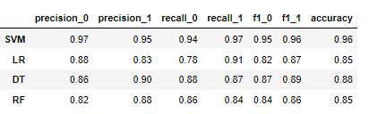
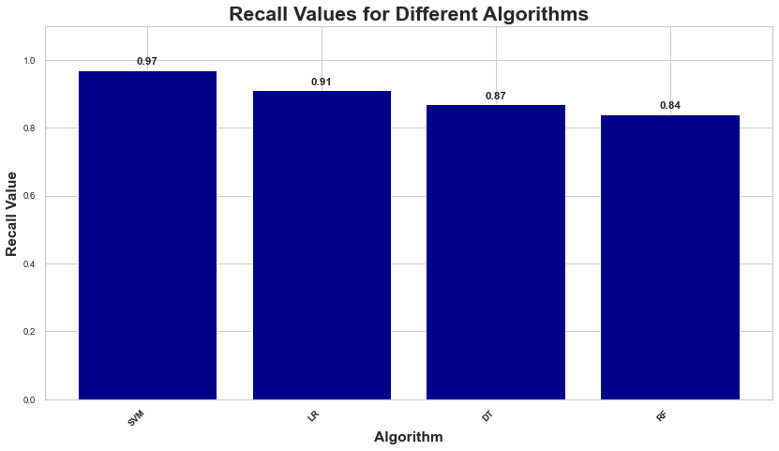
SVM Dominates: Support Vector Machine excels with 96% accuracy, balanced precision (95%) and recall (97%), showcasing superior overall classification performance.
Logistic Regression: LR achieves 85% accuracy and high recall (91%) but lower precision (83%).
Random Forest & Decision Tree Consistency: 85% accuracy, with Decision Tree having higher precision (90%) and Random Forest higher recall (86%).
Precision: The accuracy of the model when it claims to have found something.
Recall: Recall: The ability of a model to find all the relevant cases
F1 Score: A balance between recall and precision, useful when both false positives and false negatives need to be minimized.

Slide 22
Conclusion
Key Findings
The results indicated that the Support vector Machine model had the highest accuracy of 96%
The study utilized the Heart Failure Prediction dataset with 1025 instances, and all algorithms were implemented on Jupyter Notebook
Limitations
Single and Small Size Dataset Limitation:
The study relies on a single dataset, potentially limiting its generalizability to diverse populations.
Narrow Focus on Variables: :
The analysis only looks at age, gender, and medical information, without considering lifestyle choices or genetic factors that are also important for heart health.
Not Testing on New Data::
We haven't checked how well the model performs on new data it hasn't seen before. This makes us worry about whether it will work well in real-life situations.
Future research
Future research should focus on making sure that the model is reliable, works well in different situations, and is easy to understand. We need to see how duplicate or unusual data affects the model's accuracy. Finding ways to handle these problems is important for making the model better.

Slide 23

A PICTURE IS WORTH A THOUSAND WORDS
PREV
NEXT
THANK YOU VERY MUCH

